Slide 1
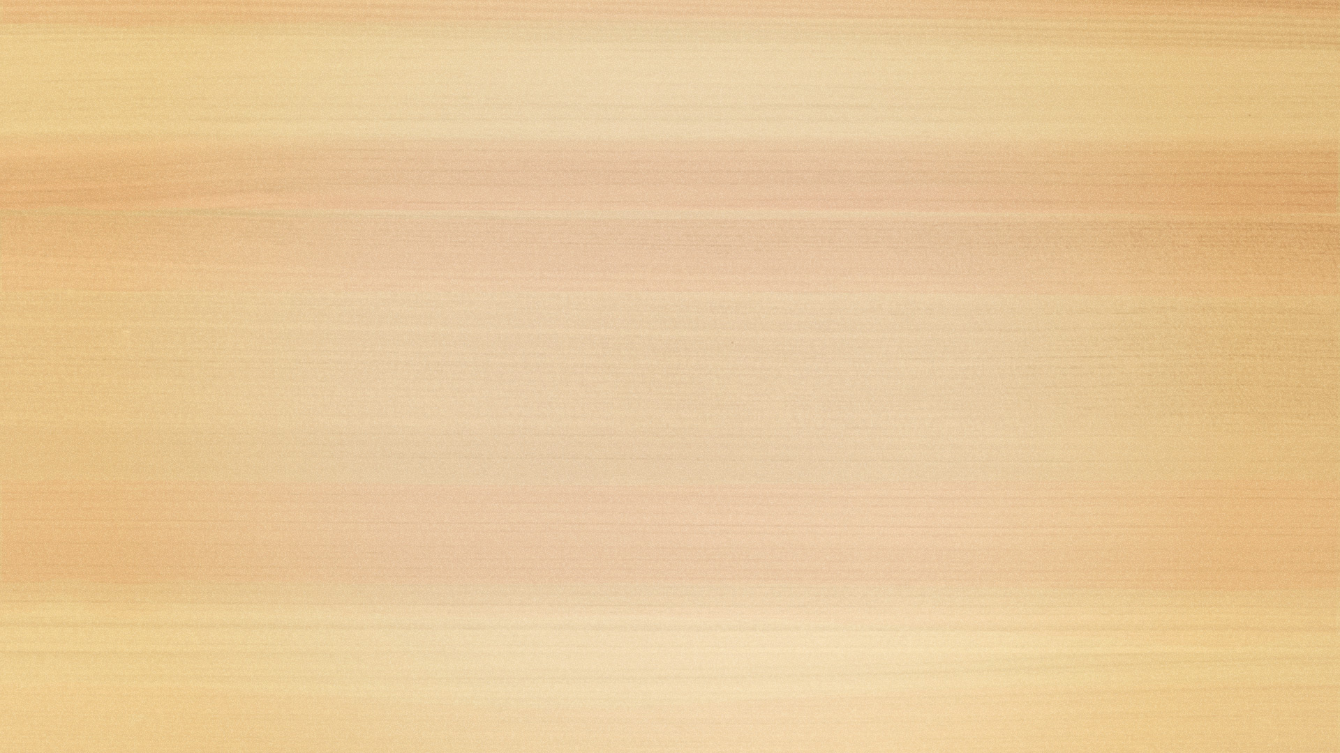
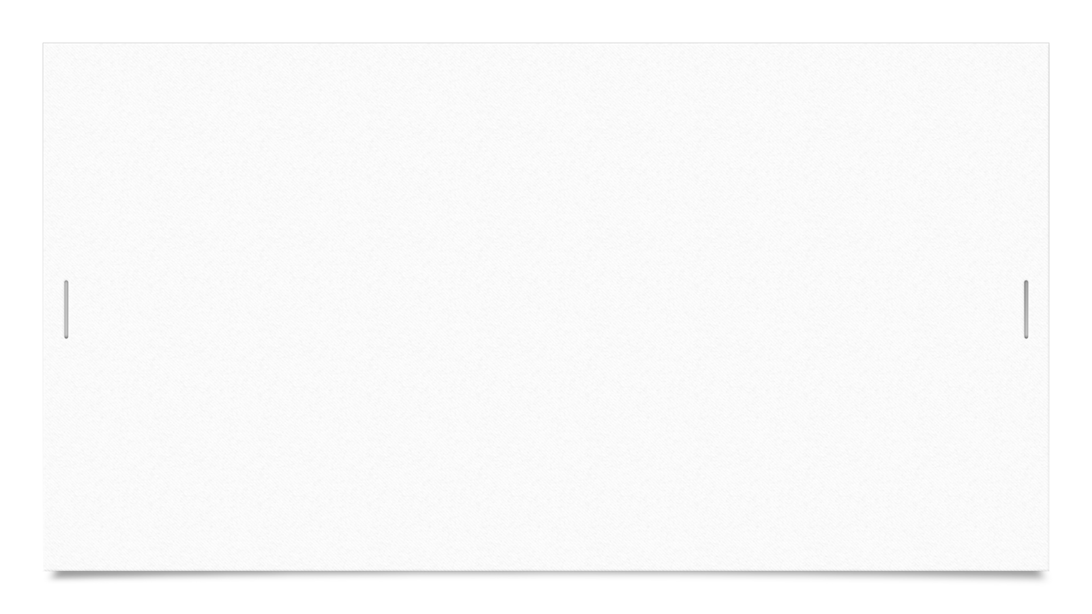
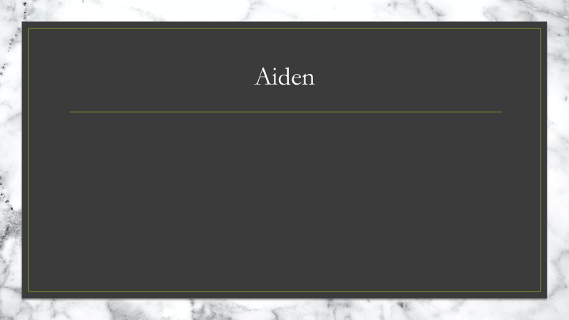
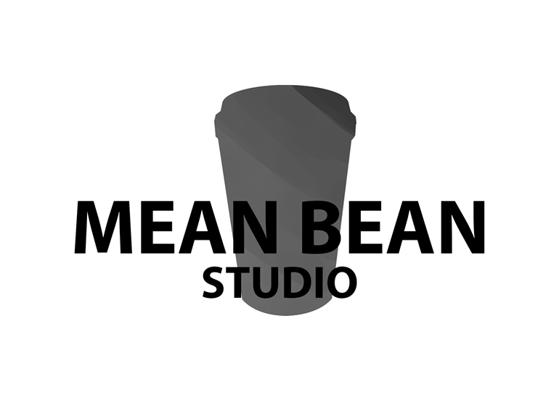
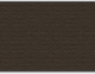
Coffee Mania Art-Bible
Mean Bean Studios
Aiden, Domenic and Tarek

Slide 2
Project overview
Coffee mania is an endless runner which will have simplistic assets which will help drive an engaging artistic experience throughout the gameplay experience.
The game will be broken into segments with unique asset designs which will expand the artistic freedoms and expressions.

Slide 3
Team members and roles
Aiden – Lead artist – Environment art
Domenic – Character artist and collectables (Animation if Tarek is unable or unwilling)
Tarek – Pathing and obstacles (Animation if viable)

Slide 4
Moodboards
Moodboards reflect the overall focus and direction of the asset or section of assets in the game. Each moodboard has documentation to help clarify what details in the board are being used and what would contribute to the final product of the game.

Slide 5
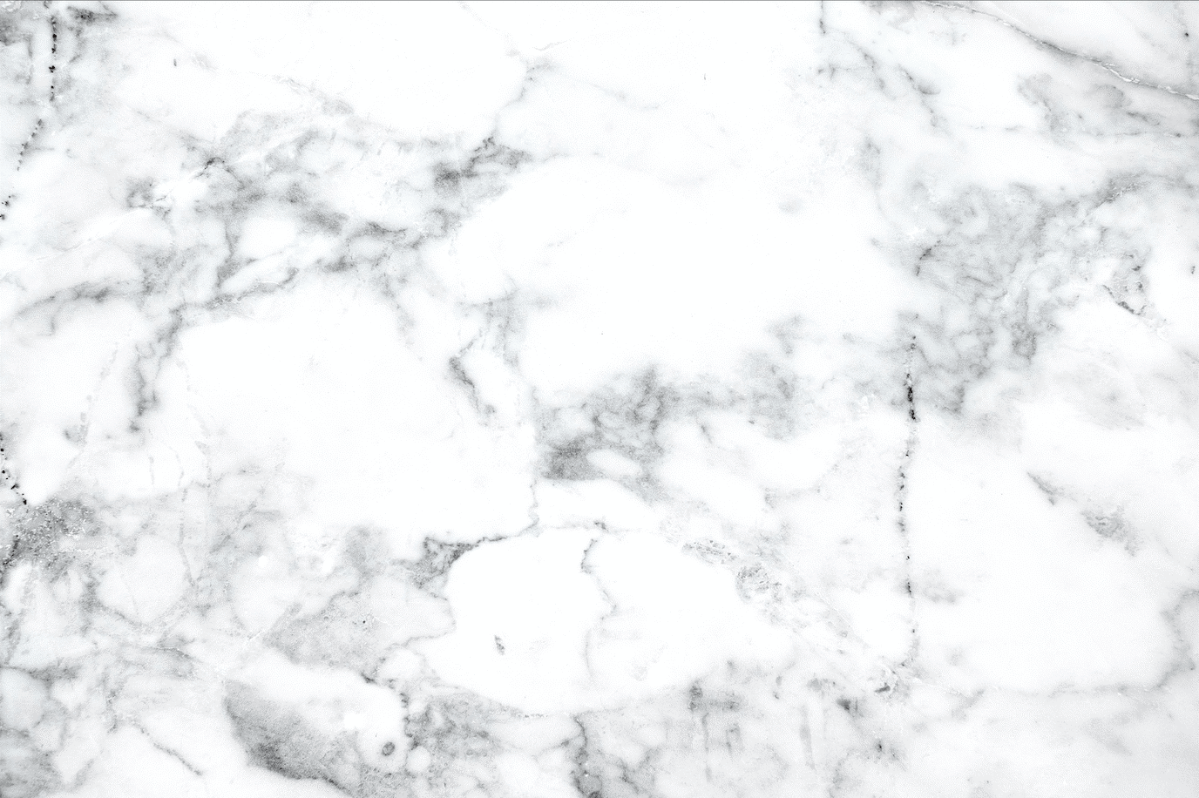

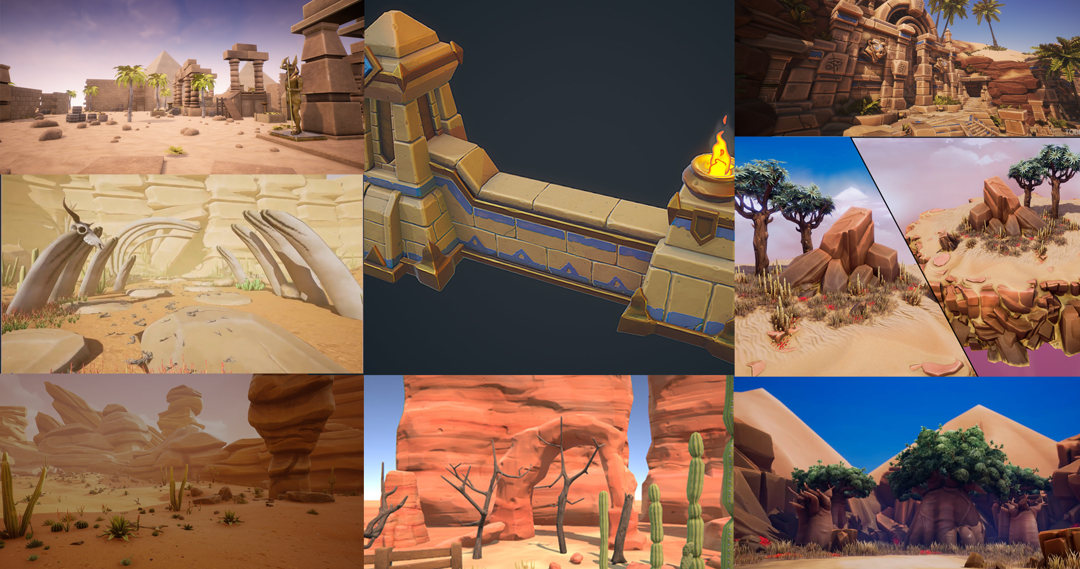
Aiden - Desert
Temple ruins or stonework adding more detail
Ground not just sand but actually populated with assets.
Stone and rocks should be a sandstone which will be soft and light.

Slide 6
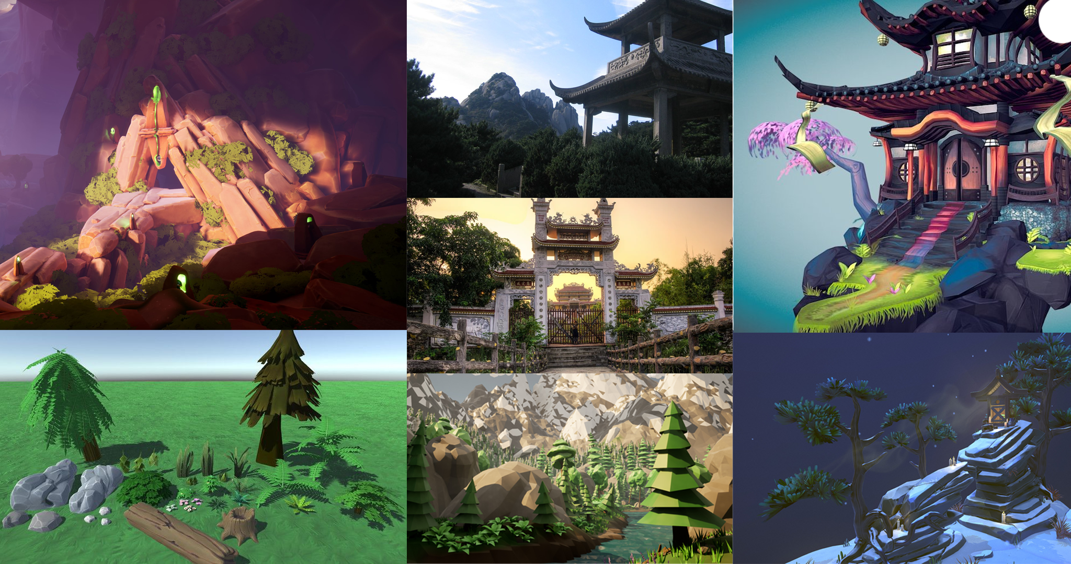
Aiden - Mountains
Lots of focus on the earth and rocks in this area, the exit from the biome should look similar to this.
Architecture should mirror Nepal and some Nepalese's pagodas
The environment will have snow and lots of alpine assets referenced here

Slide 7

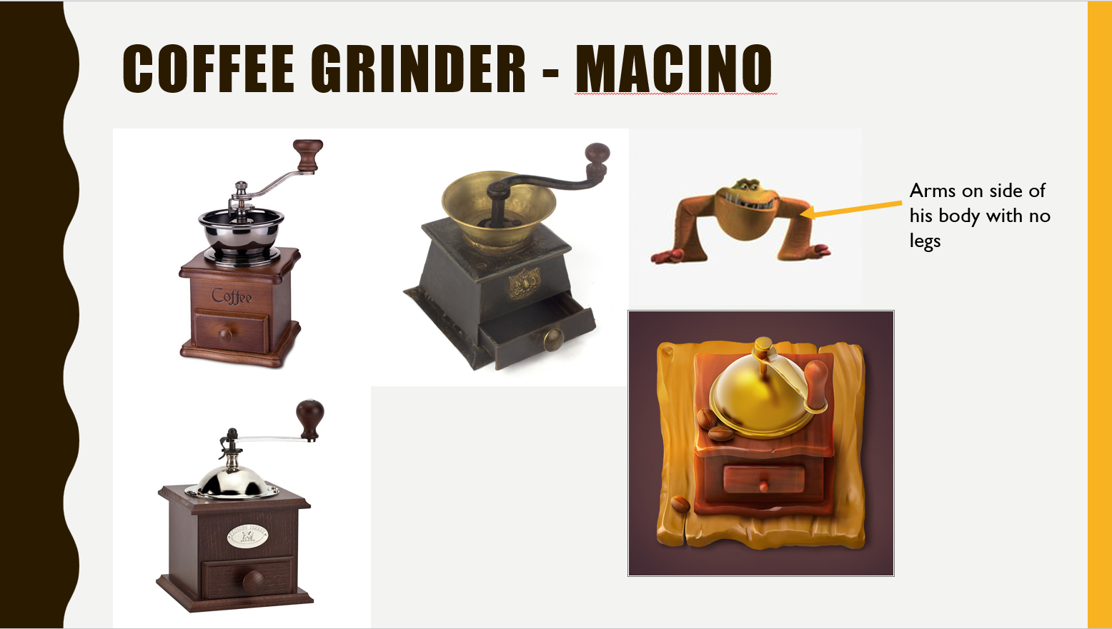

Domenic
Based on classic coffee grinders and a unique bipedal design.
Arms functions as legs to fuel movement as they chase the player.

Slide 8
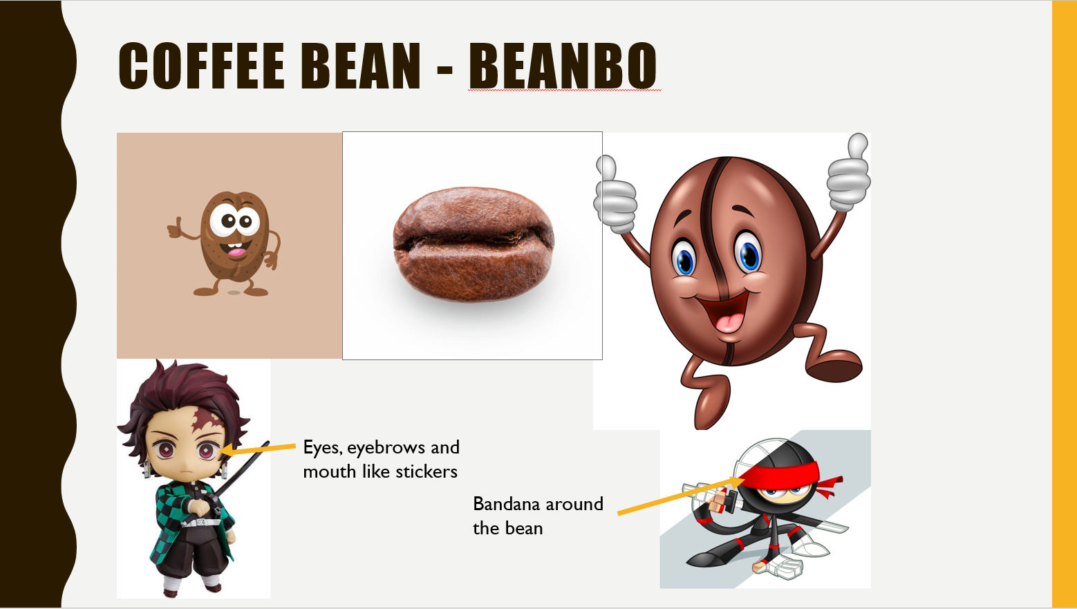
Domenic
Beanbo is a coffee bean who is trying to escape the grinder and collect more coffee beans.
His design is a rough bean with unique features.

Slide 9
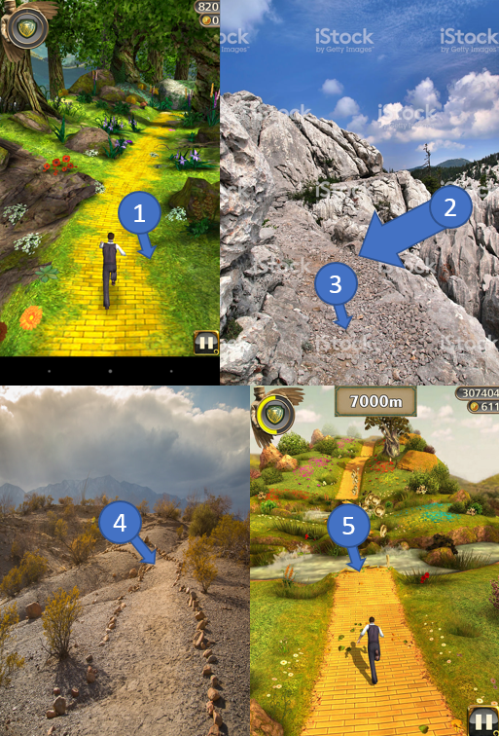

Tarek - Pathing
1. The path should look seamless with the environment
2. Pathways should not be flat and straight but instead can go up and down or curves
3. The pathway for the mountain should have lots of little rocks and less grass popping up
4. The pathway for the desert should be sandy with less rocks and pebbles popping out.
5. Rocks and Pebbles almost falling off

Slide 10
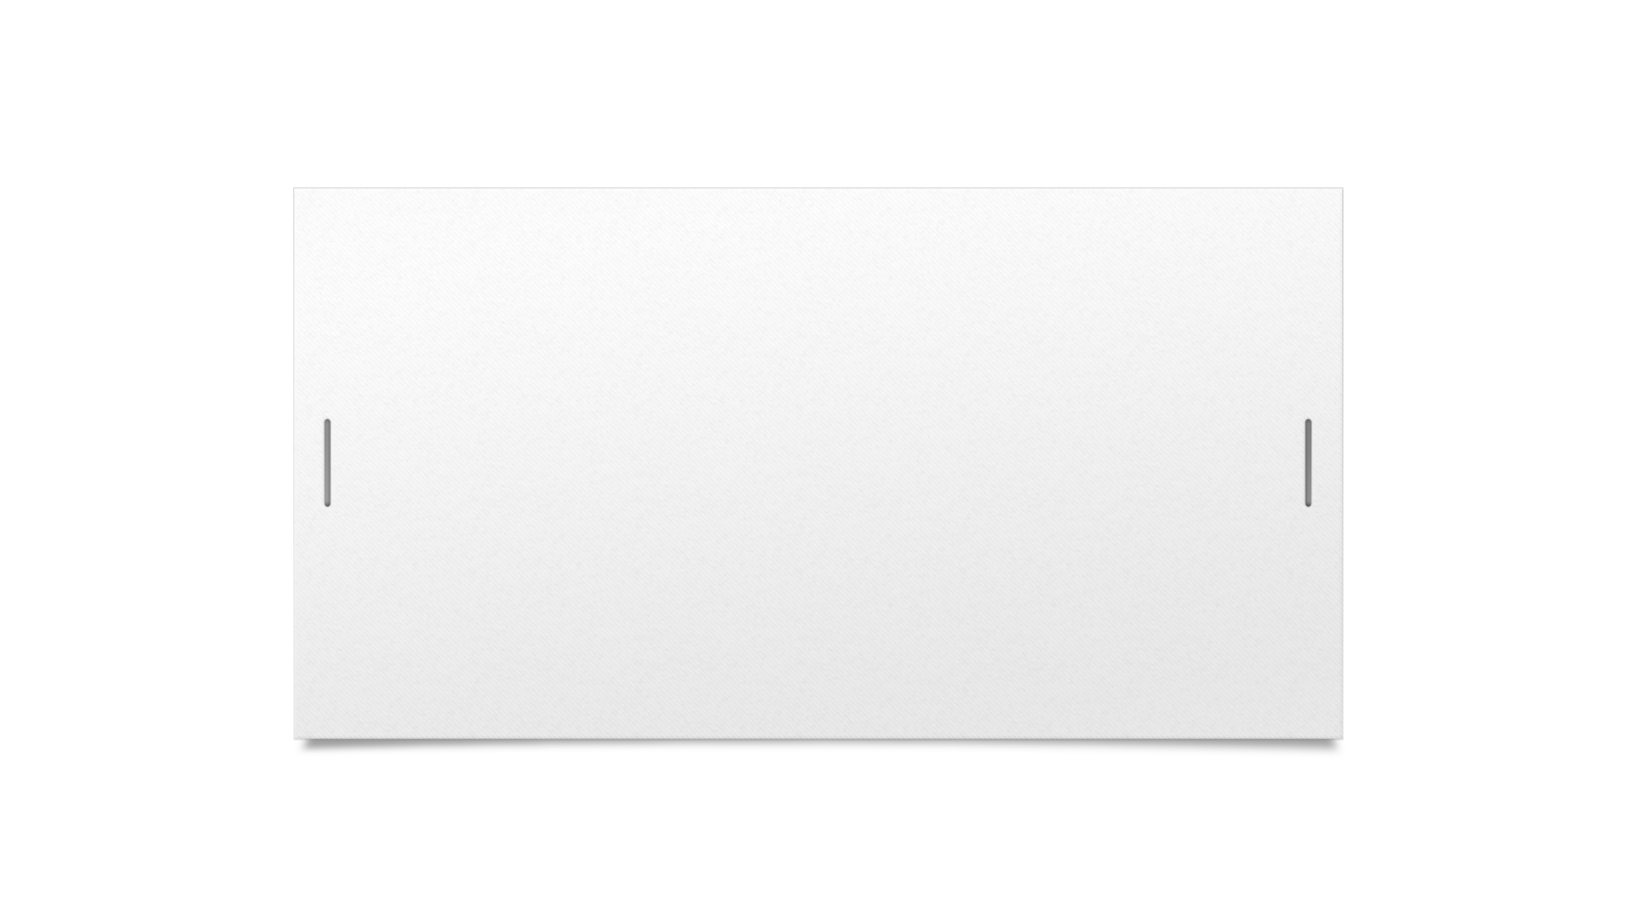
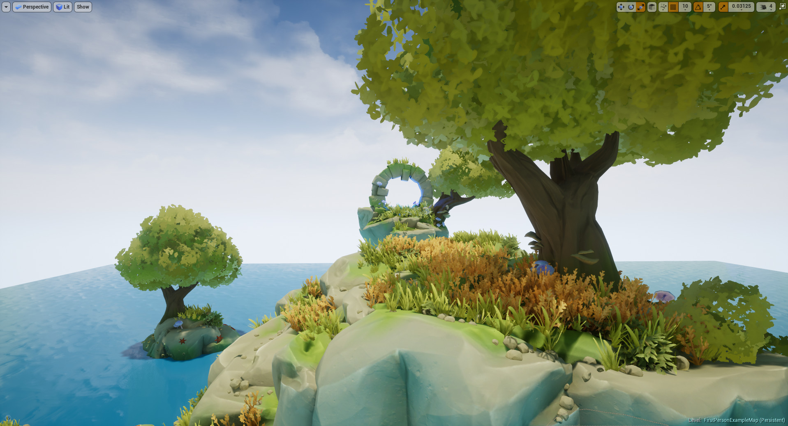
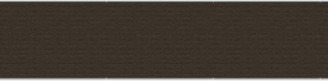
Art style Stylized PBR

Slide 11
What defines our style?
Flat colors layered to create depth use of pbr to add detail
Minimal normal information
Chiseled edges
Bright colors
High saturation
Low poly model with minimal topology

Slide 12
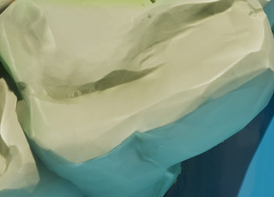
Examples of each section
Chiseled edges flat colors with minimal detail in textures. High focus on edges being distinct and hard defined shadows.
Color is layered using PBR and hand painted techniques to create a stylized take on realism.

Slide 13
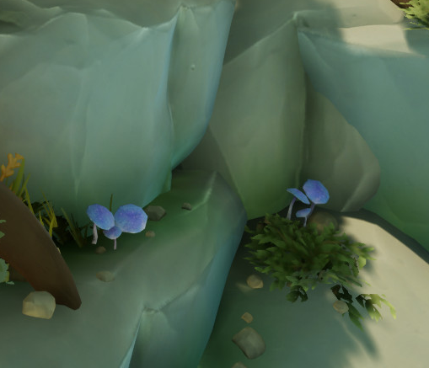
Examples of each section
The normals retain large details and a few minor flat faces however most of the detail is just in adding additional edges.
The colors are bright, saturated and fairly simple in terms of details.

Slide 14
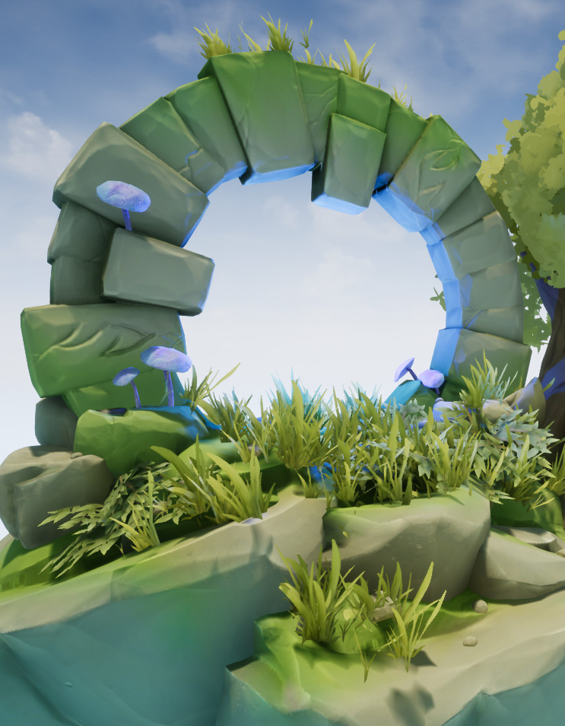
Examples of each section
All assets should be built with minimal topology and mainly rely on baking to create details.

Slide 15
A justification of the art style
Based on the current design of our narrative we have and how the stages will be laid out we believe that Stylized PBR with a mix of hand painted would be the most applicable art style.
Though the narrative that we are displaying and the way each environment will represent a growth of the character we can use clear distinctions though stylized levels to make the motifs abundantly clear.
To sum up all of our findings stylized PBR with some hand painted assets will fit best to fulfill the requirements of the brief. Our style will also help serve our strong visual narrative.
Link to a definition of PBR for further reference / reading https://www.gamasutra.com/blogs/BrandonHope/20170405/295062/Physically_Based_Rendering_and_Stylization.php

Slide 16
Concept art
Each concept is created with the intent of building upon the other assets and using sections from each as a basis for building a better version.
Concepts will have annotations and detailing to describe what is being done and why it is being done in that way.

Slide 17
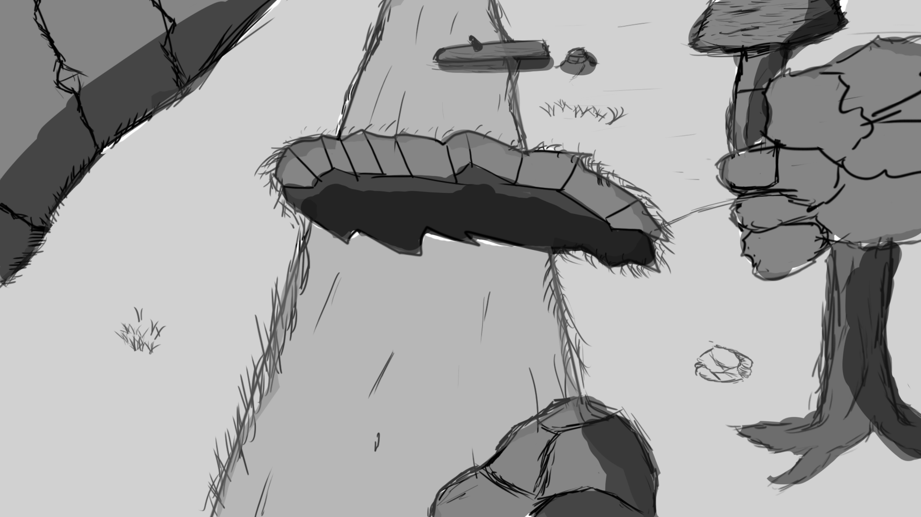
Aiden - Mountain
Small assets and holes in areas to build chunks
Tree,Rocks,Ground,Rockwall.
Consult asset guide for details.

Slide 18
Aiden – Mountain Expanded
Path will be the centerpiece.
Build modular trees, rocks and shrubs to decrease the amount of negative space.
Make each chunk feel natural by having points connect seamlessly.
Have assets in the background that justify the obstacles eg. Tree stump
Use the color and brightness of the environment vs the path to draw focus.

Slide 19
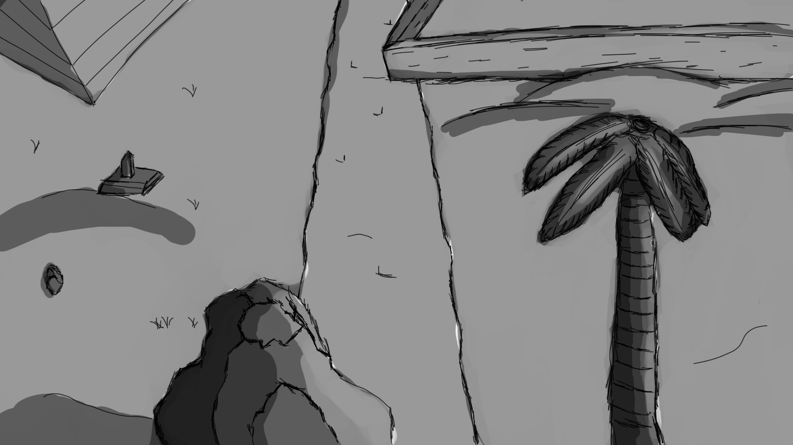
Aiden - Desert
Small assets and holes in areas to build chunks
Tree, Rocks, Ground, bricks to build structures.
Consult asset guide for details.

Slide 20
Aiden – Desert Expanded
Path will be the centerpiece.
Build modular assets to build unique structures and environments in each chunk.
Try to use negative space to draw focus to the areas where assets are populated.
It is a desert but we should not have large sections with nothing but sand as this will be boring, to fix this use small details like rocks to break the mundane environment.

Slide 21
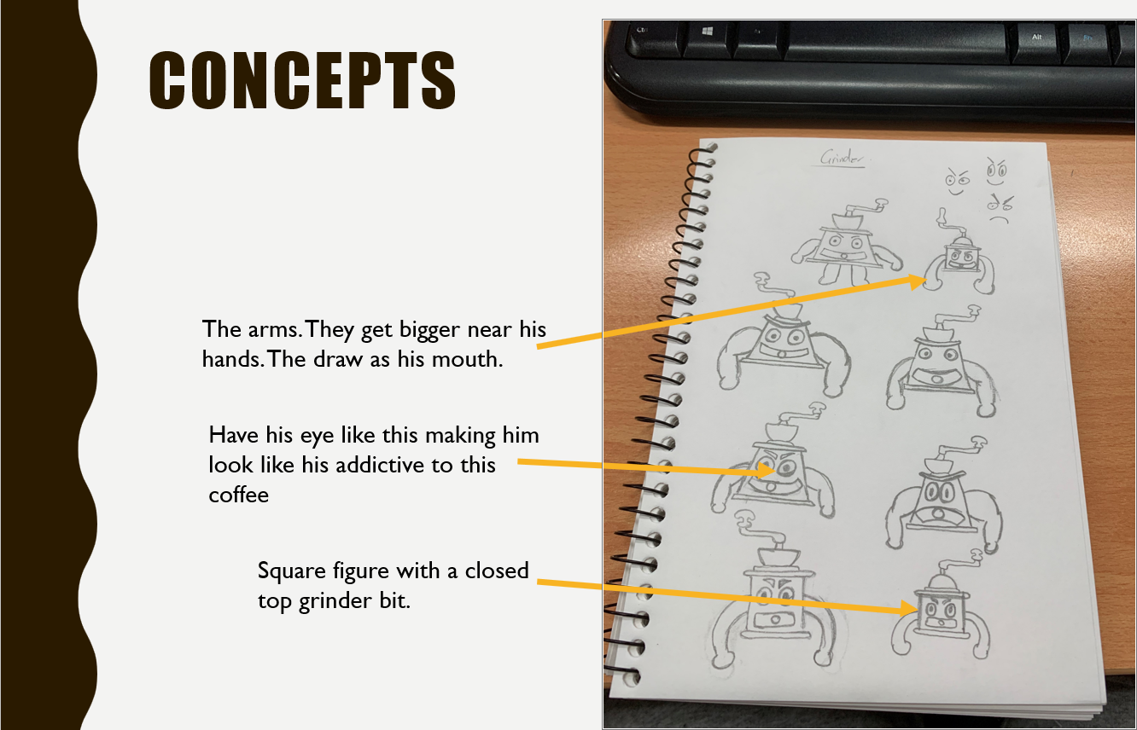
Domenic
Concepts for the antagonist and their visual appeal / design.

Slide 22
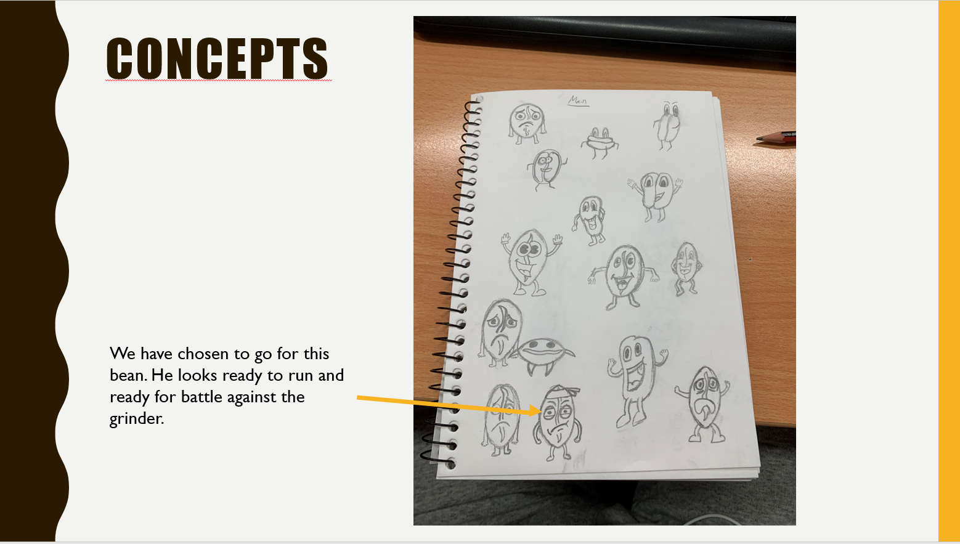
Domenic
Concepts for the protagonist and their visual appeal / design.
The bandana can be used as a point of contrast to draw focus to the character.

Slide 23
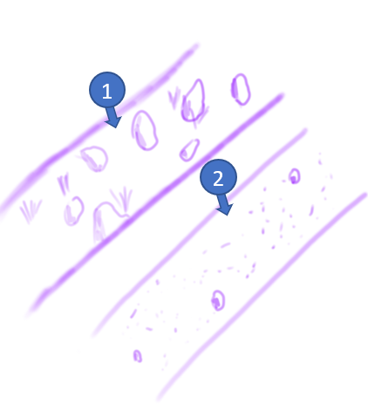
Tarek - Pathing
1. Mountain pathway have lots of rocks and less grass
2. Desert pathway have shows mostly sand but with less small rocks
Can use bricks and other environmental specific details to add more depth to the path.

Slide 24
Color palletes
The main focus with our colors will be to create a contrast that helps make each environment and detail interesting. Lighting will be attached to the environment and will have minor changes to further enhance the users experience. User interface will be designed with a focus on minimalism and nonintrusive colors.

Slide 25
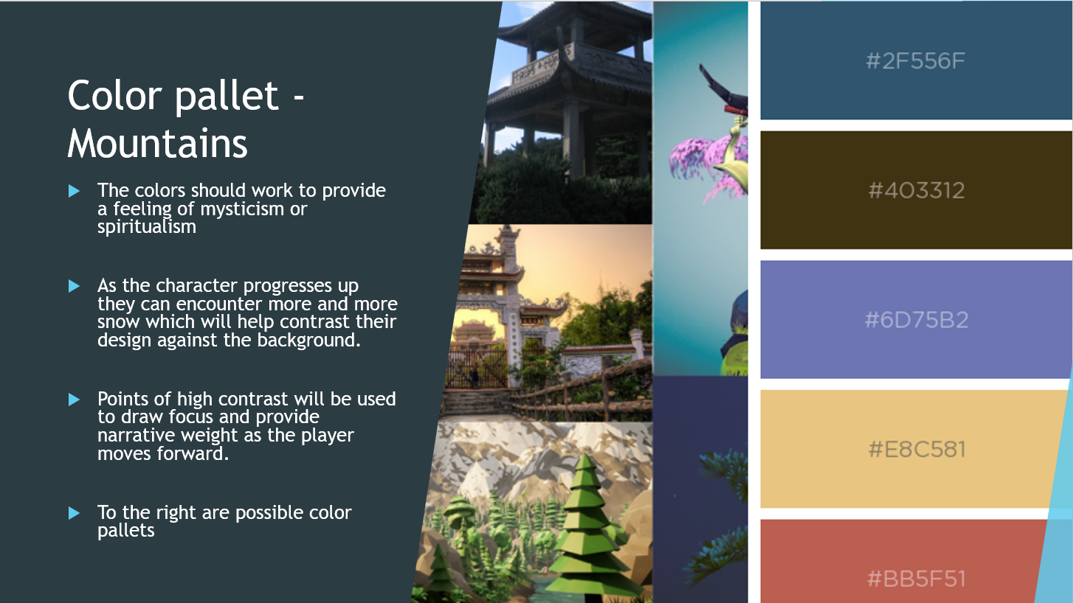
Mountains

Slide 26
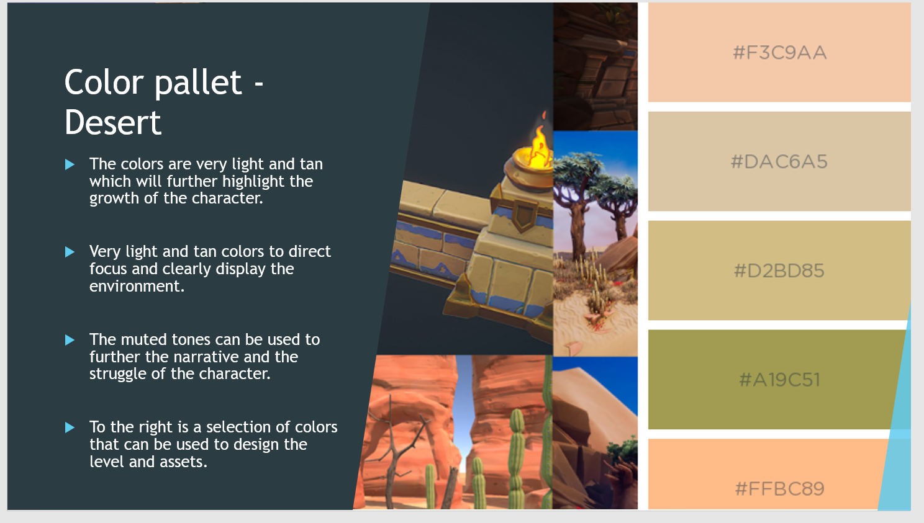
Desert

Slide 27
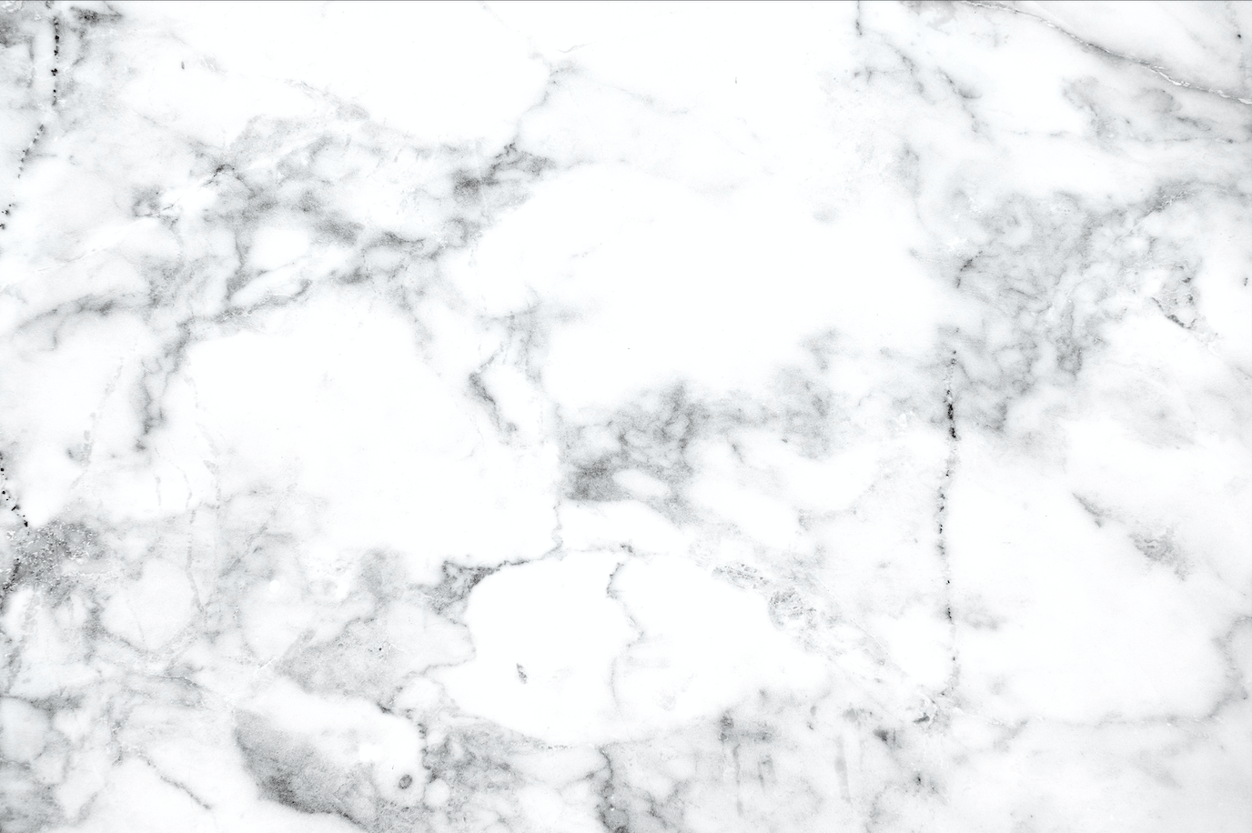
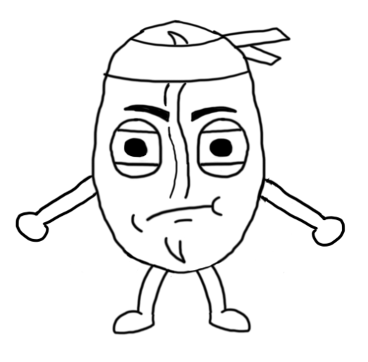
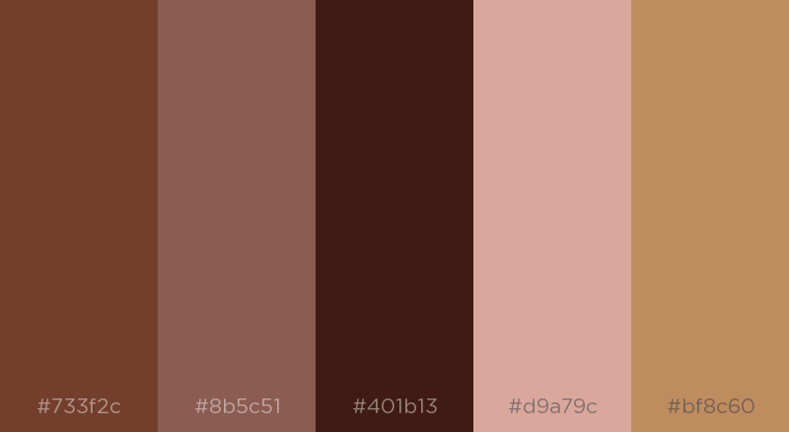
Character
The character will be using primarily colors that integrate with a typical coffee. In addition we may use a bright color to help draw focus onto the character in the environments.

Slide 28
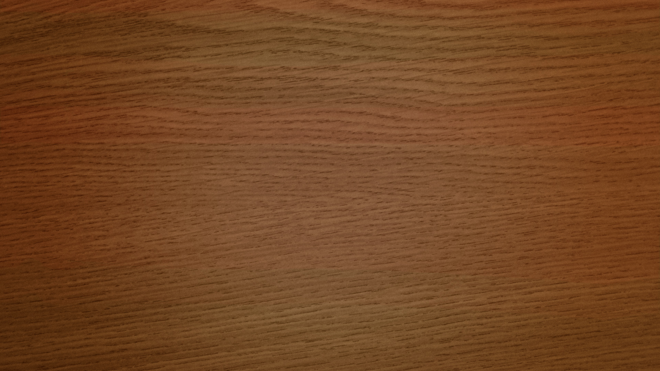
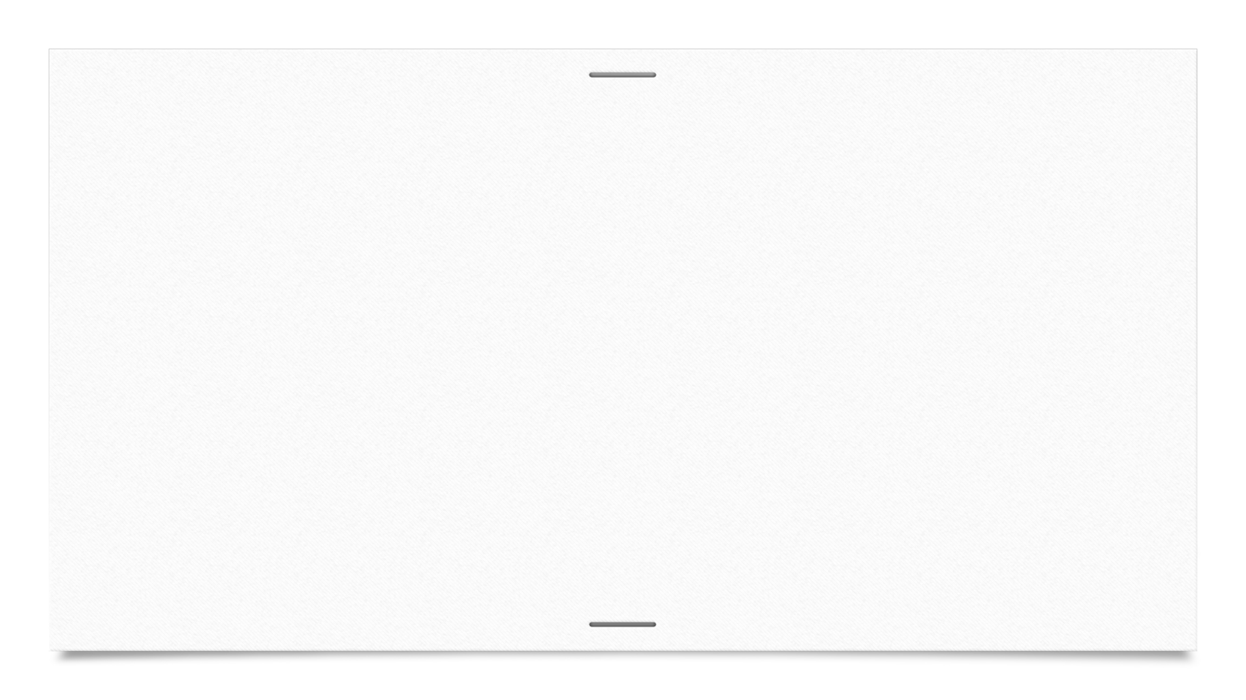
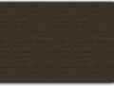
Asset list
Background img-Mountains
Background img-Desert
Foliage-Mountain x2
Foliage-Desert x2
Rock-Mountain x2
Rock-Desert x2
Ground plane-Mountain
Ground plane-Desert
Mountain-Mountain
Hill-Desert
Tree-Mountainx2
Tree-Desert

Slide 29
Asset list
Bricks-Mountains
Bricks-Desert
Wooden plank x2
---------------------------------------
Macino
Beanbo
Milk
CoffeeBean
Sugar
Net
Ice
Tea

Slide 30
Asset list
BaristaKnife
-------------------------------------
aaaaa

Slide 31
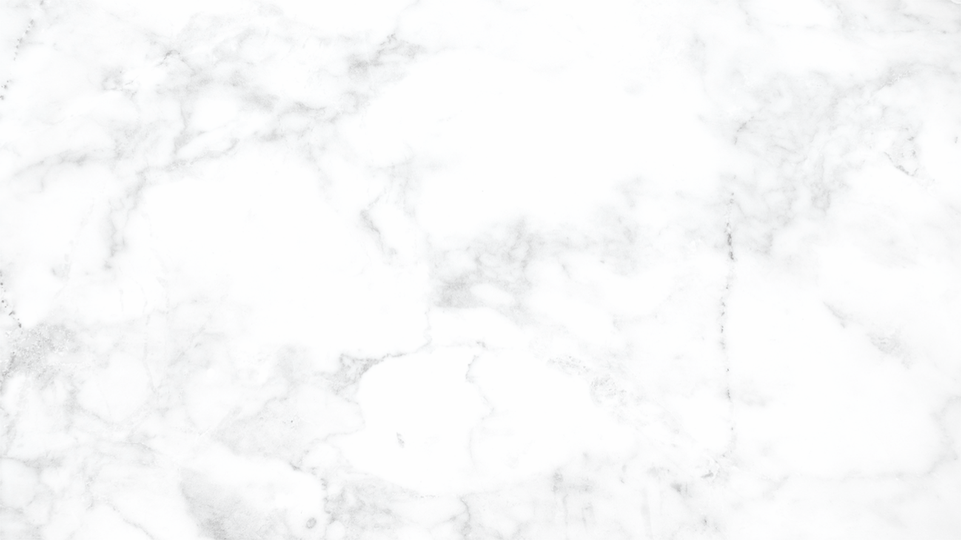
Asset list Expanded-Aiden
Asset | Poly count | Textures | Texture size | Description | Notes
Background Mountain | 2 tri | Albedo | 1024x1024 | Image plane of mountains / sky
Background Desert | 2 tri | Albedo | 1024x1024 | Image plane of mountain / sky
Foliage Mountain | 3000 tri | Albedo Specular Alpha Normal Gloss | 1024x1024 | Two types of plants used to populate the ground | Two unique assets to provide better variation
Foliage Desert | 3000 tri | Albedo Specular Alpha Normal Gloss | 1024x1024 | Two type of plants used to populate the ground | Two unique assets to provide better variation

Slide 32
Asset list Expanded-Aiden
Asset | Poly count | Textures | Texture size | Description | Notes
Rock Mountain | 2500 tri | Albedo Specular Alpha Normal Gloss | 1024x1024 | Two types of rocks used to populate the environment | Two assets which will be used to populate the scene
Rock Desert | 2500 tri | Albedo Specular Alpha Normal Gloss | 1024x1024 | Two types of rocks used to populate the environment | Two assets which will be used to populate the scene
Ground plane Mountain | 2000 tri | Albedo Specular Alpha Normal Gloss | 1024x1024 | A ground plane to cover most of the environment
Ground plane Desert | 2000 tri | Albedo Specular Alpha Normal Gloss | 1024x1024 | A ground plane to cover most of the environment

Slide 33
Asset list Expanded-Aiden
Asset | Poly count | Textures | Texture size | Description | Notes
Mountain Mountain | 2000 tri | Albedo Specular Alpha Normal Gloss | 512x512 | A mountain used to change the environment | The transition point from mountain to desert
Hill Desert | 2000 tri | Albedo Specular Alpha Normal Gloss | 512x512 | A hill that will have stairs to transition to the mountains | The transition point to the mountains from the desert
Tree Mountain | 2000 tri | Albedo Specular Alpha Normal Gloss | 1024x1024 | Trees that can be used to further populate the scene
Tree Desert | 2000 tri | Albedo Specular Alpha Normal Gloss | 1024x1024 | A tree that can be used to further populate the scene

Slide 34
Asset list Expanded-Aiden
Asset | Poly count | Textures | Texture size | Description | Notes
Bricks/ruins Mountain | 2000 tri | Albedo Specular Alpha Normal Gloss | 1024x1024 | Small ruins/ bricks to add interest to the environment.
Bricks/ruins Desert | 2000 tri | Albedo Specular Alpha Normal Gloss | 1024x1024 | Small ruins/ bricks to add interest to the environment
Wooden planks | 2000 tri | Albedo Specular Alpha Normal Gloss | 1024x1024 | Wooden planks that can be used with the ruins or to build other structures | Build two types to allow for greater variation.

Slide 35
Asset list Expanded -Domenic
Asset | Poly count | Textures | Texture size | Description | Notes
Machino |  | Albedo Specular Alpha Normal Gloss | 1024x1024 | Villain that chases Beanbo throughout the game
Beanbo |  | Albedo Specular Alpha Normal Gloss | 1024x1024 | The main character which the player will control | Will have animations listed on the animation slide
Milk |  | Albedo Specular Alpha Normal Gloss | 1024x1024 | One of the collectable powerups
Coffee bean |  | Albedo Specular Alpha Normal Gloss | 1024x1024 | The main score reward the player collects

Slide 36
Asset list Expanded -Domenic
Asset | Poly count | Textures | Texture size | Description | Notes
Sugar |  | Albedo Specular Alpha Normal Gloss | 1024x1024 | A buff that will help the player get better scores
Net |  | Albedo Specular Alpha Normal Gloss | 1024x1024 | Another collectable that will be used to enhance gameplay
Ice |  | Albedo Specular Alpha Normal Gloss | 1024x1024 | One of the collectable powerups
Tea |  | Albedo Specular Alpha Normal Gloss | 1024x1024 | Another collectable that will be used to enhance gameplay

Slide 37
Asset list Expanded -Domenic
Asset | Poly count | Textures | Texture size | Description | Notes
Barista knife |  | Albedo Specular Alpha Normal Gloss | 1024x1024 | A collectable that will help the player

Slide 38
Animation asset list
Animation | Animation length | Description | Notes & Rig
Beanbo - Run | 24-48 Frames Looping | A run cycle of the main character. | Yes- staying in place looks like they are moving with dynamic background.
Beanbo - Collision | 18 Frames | The main character hitting and obstacle and falling down. | Yes- Does not interact with the object hits and falls slightly before to save time
Beanbo - Idle Loop | 24 Frames Looping | The character doing a little idle animation to make the screen more interesting | Yes – Made for the main screen and to create appeal
Macino - Run | 24-48 Frames Looping | The grinder running to catch the player | Yes – Functions the same as the player run cycle
Macino - Catch | 24-72 Frames | The grinder grabbing the character and eating them | Yes – A few seconds depends on the technical abilities and time of the animator

Slide 39
Art tools
Tools which will be used to create the art for the project will include
Photoshop
Substance painter
Substance designer
Maya
Zbrush
Unity asset packs if needed

Slide 40
Photoshop
Photoshop will be used to concept and create key outlines or touchups in textures.
Photoshop will also be used to create any 2D assets of detailing that we need
The justification for this software lies in the abilities of the artists and the software's dynamic uses which can be applied effectively to achieve goals.

Slide 41
Maya
Maya will be used to create the models and the final topology for all of the assets.
Maya was chosen again based on the abilities of all the team members, which means each team member should be fully competent with the software resulting in efficient workflow.

Slide 42
Zbrush
Zbrush will be used to create detailing and extra information which will be baked allowing for higher quality assets without needing as much topology per asset.
Zbrush was selected for its compatibility with Maya and Substance which allows for easy baking and quick integration into the pipeline.

Slide 43
Substance Painter
Substance painter will be the main program to texture all assets. Furthermore, it will be used for baking all assets which will be a vital step in the pipeline.

Slide 44
Substance Designer
Given the need for seamless repetitive textures using Substance Designer would be an ideal system to learn to allow effective asset texturing.
The only downside is there is a lack of skill and understanding when it comes to this software amongst the artists.

Slide 45
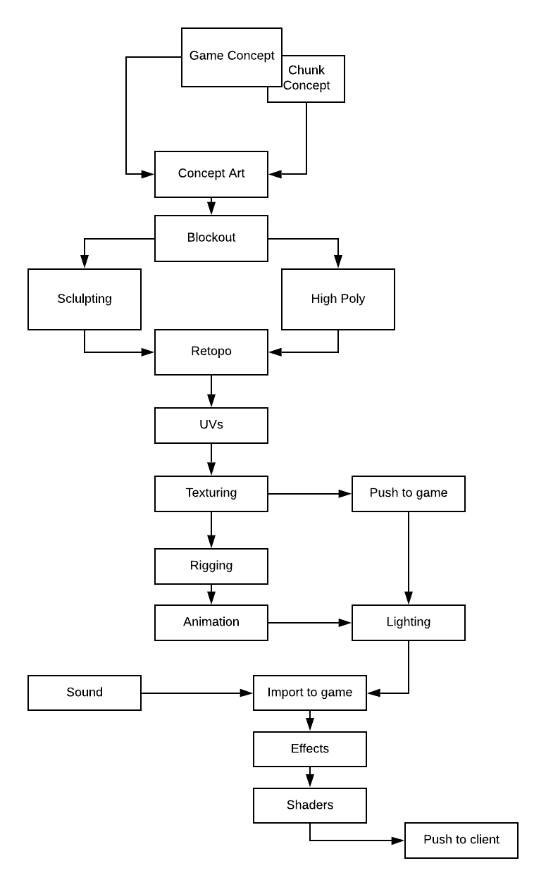
Pipeline Diagram
The movement of game art assets though the pipeline will focus on quality and effective use of time.
The biggest bottleneck and area for concern is the pushing to game, this could be an issue if assets are done incorrectly as it would delay the final push.

Slide 46
Technical Guidelines
Project will be conducted in Unity 2018.2.5f1 for a Windows PC
All assets will be exported as .fbx
Textures will be exported as .png

Slide 47
Naming Conventions
AssetnameAlbedo.png
AssetnameAlpha.png
AssetnameGloss.png
AssetnameSpecular.png
AssetnameEmission.png
Assetname.fbx
AssetnameAnimation.fbx

Slide 48
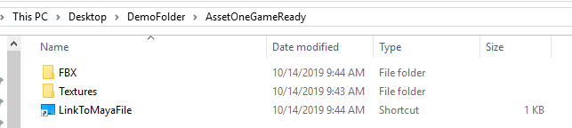
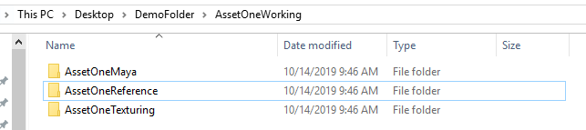
File Format
All files should be in appropriate folders.
Shortcuts should be used to link to other folders if used.
Example:
Environment>Mountains> ConifirTree>ConifirTreeTextures> ConifirTreeAlbedo.png

Slide 49
Limitations and Requirements
All assets should aim to be under 7,000 tris
All textures should be aiming to be under 1k resolution
Assets should be modular
Any environmental asset should be seamless unless a direct reason is given for it to not be.

